Slide 1
38th meeting of the EU-Turkey
Joint Consultative Committee (JCC)
SMEs-Trade development and investment environment opportunities between the EU and Turkey
April 8, 2019
Brussels

Slide 2
SMEs matter…
SMEs are the main pillar of nearly all national economies in the world.
They generate more than a half of jobs and income as well as value added.
SMEs contribute to economic growth and innovation.
They are increasingly integrated in global value chains, and form a working ecosystem with larger enterprises.
They are engaged in and deeply affected by the trading and investment environment (i.e. doing business and trade protectionism).

Slide 3
Challenges for the SMEs
Limited access to finance
Lower R&D, low intensity of technology use
Limited internationalization and global supply chain (GVC) integration
Regulatory environment
Market access problems
Limited skilled labor and productivity

Slide 4
SMEs in Turkey’s economy, 2014-2016

Slide 5
Share of SMEs in foreign trade in TR, 2015 (TÜİK)

Slide 6
Why GVC participation is essential
Trade, and Global Value Chain (GVCs) create opportunities for SMEs:
  to absorb spillovers of technology, managerial knowledge
  to innovate
  to enhance productivity
  welfare gains from SME internationalization.
  OECD (2018), Fostering greater SME participation in a globally integrated economy.

Slide 7
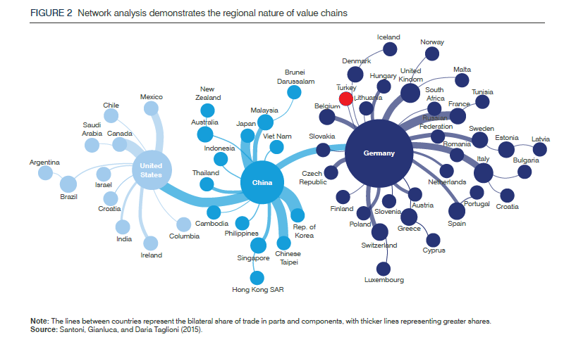
TR SMEs mostly integrated to regional (European) VCs

Slide 8
TR needs to increase high-tech exports
High-technology exports in G20 countries, as a share of manufactured exports, %, 1992 & 2017
Source: World Bank
.

Slide 9
Forward linkage signifying GVC participation declined in TR, while backward risen
Backward participation
Backward participation
measures import content of a country’s export
Forward participation measures domestic value added embodied in foreign countries’ exports
Forward participation
Source: OECD (2016). OECD Economic Surveys Turkey July 2016 Overview, TEPAV calculations
Notes:
İran var mı bu kısımda?

Slide 10
FDI facilitates GVC integration (forward linkages)
Forward participation in exports and FDI Stocks
Forward Link: Contribution of Local Economies to GVC
Log (Embodied local domestic value in foreign exports, million USD $)
12.5
JPN
CHN
DEU
ITA
RUS
USA
KOR
IND
FRA
GBR
POL
IDN
MEX
CAN
CHE
FIN
TWN
MYS
AUT
BRA
10.0
CZE
THA
SAU
ESP
HUN
TUR
CHL
SWE
BEL
SVK
ROU
AUS
NLD
SGP
PHL
DNK
NOR
IRL
SVN
ISR
PRT
ZAF
VNM
ARG
LTU
GRC
NZL
COL
HKG
7.5
BGR
LVA
CRI
LUX
TUN
ISL
EST
HRV
KHM
5.0
CYP
MLT
BRN
8
10
12
14
FDI Stock
log(FDI stock, million USD $)
Source: OECD TIVA database, TEPAV calculations

Slide 11
SME integration to GVCs: Turkey
Several important factors to boost SME competitiveness and GVC integration:
  to improve access to finance
  to cope with the digital transformation
  to live in better regulatory environment and the rule of law
  to better integrate into the trading system, and to boost trade capacity.

Slide 12
Access to finance
Strenghten financial market infrastructure for SMEs
  G20/OECD High Level Principles on SME financing
  impact assessment on financial regulation about SME lending, insolvency rules…
Facilitate access to financial instruments
  Boosting financial literacy of SMEs
Enhance digital financial inclusion
  Boosting SMEs for digital finance, electronic invoicing…

Slide 13
Financial inclusion:
Shares of the Credit provided to SMEs in Selected Countries, (2016)

Slide 14
Digitalization and SMEs
Potential Benefits of Digitalization for SMEs:
Greater access to markets: E-Commerce and the Internet lower costs for transaction while reducing the need for physical infrastructure/presence in foreign market
More access to financing: new opportunities for SMEs to obtain funding.
Greater access to technology and applications: Through cloud services (improved ICT) SMEs can access a wide range of technologies and applications.

Slide 15
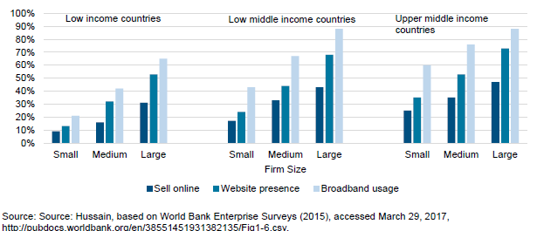
SMEs use internet less intensively

Slide 16
Regulatory environment and the rule of law
GVCs need FDI which needs good invetsment environment:
Doing Business in Turkey
Rule of Law index
World Governance Indicators
…..

Slide 17
Turkey ranked 60-70 for years
Doing Business Index, World ranking, 2009-2019
Best performance achieved by Turkey in the last decade, 2019

Slide 18
Action Plan by 107 articles
COORDINATION COUNCIL FOR THE IMPROVEMENT OF INVESTMENT ENVIRONMENT (YOİKK ) 2017-2018 ACTION PLAN TABLE BY INDICATORS
MINISTRY/INDICATOR | Starting business | Construction permits | Getting electricity | Registering property | Paying taxes | Trading accross borders | Getting credit | Enforcing contracts | Resolving insolvency | STK | TOTAL
JUSTICE |  |  |  |  |  |  | 2 | 4 | 10 | - | 16
SCIENCE, INDUSTRY AND TECHNOLOGY |  |  |  |  |  |  |  |  |  | 3 | 3
LABOUR AND SOCIAL SECURİTY | 1 | 2 |  |  | 1 |  |  |  |  | 6 | 10
ENVIRONMENT AND URBAN AFFAIRS |  | 8 |  | 6 |  |  |  |  |  | - | 14
ECONOMY |  |  |  |  |  |  |  |  |  | 2 | 2
ENERGY AND NATURAL RESOURCES |  |  | 2 |  |  |  |  |  |  | 2 | 4
FOOD, AGRICULTURE AND LIVESTOCK |  |  |  |  |  |  |  |  |  | 1 | 1
CUSTOMS AND TRADE | 7 |  |  |  |  | 8 | 2 |  |  | 5 | 22
HOME AFFAIRS |  | 9 | 1 |  | 1 |  |  |  |  | - | 11
DEVELOPMENT |  |  |  |  |  |  |  |  |  | 1 | 1
FINANCE | 2 | 1 |  |  | 6 |  |  | 1 |  | 6 | 16
TRANSPORT. AND COMMUNICATION |  |  |  |  |  | 3 |  |  |  | 1 | 4
TREASURY |  |  |  |  |  |  | 1 |  |  | 1 | 2
TBB Risk C. |  |  |  |  |  |  | 1 |  |  | - | 1
TOTAL* | 10 | 20 | 3 | 6 | 8 | 11 | 6 | 5 | 10 | 28 | 107

Slide 19
Getting better in Doing Business index
 | DB 2018 | DB 2019 | Change
Starting a business | 80 | 78 | +2
Dealing with construction permits | 96 | 59 | +37
Getting electricity | 55 | 60 | -5
Registering property | 46 | 39 | +7
Getting credit | 77 | 32 | +45
Protecting minority investors | 20 | 26 | -6
Paying taxes | 88 | 80 | +8
Trading accross borders | 71 | 42 | +29
Enforcing contracts | 30 | 19 | +11
Resolving insolvency | 139 | 109 | +30
Overall ranking | 60 | 43 | +17
Turkey is among the 10 most improved economy in DB

Slide 20
Rule of Law
High tech FDI is needed to bring positive spillovers for productivity, technology.
For Turkish SMEs to integrate into GVCs.
…. but this is possible by means of
more stability.

Slide 21
Needs to improve in Rule of Law index
Turkey’s Rule of Law Index indicators, 2012 & 2019
WJP Rule Of Law Index Factors | Ranking, 2019
Constraints on Government Powers | 123/126
Absence of Corruption | 57/126
Open Government | 94/126
Fundamental Rights | 122/126
Order and Security | 96/126
Regulatory Enforcement | 106/126
Civil Justice | 96/126
Criminal Justice | 85/126
Source: World Justice Project, TEPAV calculations (unweighted average)
Note: Outer side represents higher score

Slide 22
Turkey needs to decide where it stands
WB World Governance Indicators, percentile rankings of EU-28, MENA and Turkey, 2017
Source: World Governance Indicators, TEPAV calculations (unweighted average)
Note: Outer side represents higher score

Slide 23
SMEs and trade barriers
Barriers to SMEs access to global markets:
  (i) limited information about the working of the foreign markets, difficulties in accessing export distribution channels;
  (ii) costly product standards and certification procedures,
  (iii) burdensome customs regulations/procedures;
  (iv) poor access to finance and slow payment mechanisms.
  WTO World Trade Report,2016

Slide 24
SMEs voice in CU process
Deeper regional integration is a bluprint for SME success…
More attention to the specific needs of SMEs in the customs union.
  Specific SME-friendly chapter
    Database listing all regulatory requirements for compliance
    trade facilitation (how to reform cumbersome procedures)-TFA
    Ellimination of unnecessary hurdles and simplify RoO
    capacity building in digital trade and e-commerce (Alibaba/Kompass)
    SME committee to follow up implementation
  Deepening CU into agriculture and trade in services
    to promote productivity in services and agricultural enterprises
    Service trade restrictions represent 10-20 % of tariff equivalence
    to reduce farm prices that can minimize labour costs in urban areas (working mostly in SMEs)

Slide 25
Opportunities are mutual for EU and TR SMEs: if trading framework between the EU and TR is enhanced
EU SMEs
Turkey’s SMEs
  Dairy products
  Processed foods
  Fruit and vegetables
  Basic chemicals and plastics (value chain integration for intermediate products)
  Auto, machinary and electrical equipment
  Business and professional services- and trade services (wholesale and retailing)
  Processed foods
  Fruit and vegetables
  Textile, clothing and footwear (also to third markets)
  Trade, construction and transport services, recreational services, logistics
Source: BKP (2016) for the European Commission.

Slide 26
Customs Union and SMEs
Opening negotiations for an upgraded CU can help
European and Turkish SMEs to benefit mutually as well as in third country markets.
CU is a technical issue, which should not be politicized.

Slide 27
The EU acquis directly relevant to SMEs
Chapter not closed/not yet opened
Chapter subject to political blockage
Public procurement
Company law
Intellectual property law
Competition
Information society &media
Food security, veterinary& phytosanitary policy
Taxation
Social policy and employm.
Enterprise and industrial p.
Regional policy…
Environment
Consumer&health protection
Free movement of goods (CE marking)
Financial services
Agriculture and rural development
Customs union
Freedom to provide services
Education&culture
Energy

Slide 28
Conclusions
Need for a new approach to internationalize SMEs and their linkage with the GVCs
Strong and credible program with a new SME-driven narrative
  Turkey transformed itself from low-tech to mid-tech industrial country through EU engagement
  Now is the time for the next jump (especially for its SMEs)
Choosing priorities is a good starting point
  Customs Union is an area of opportunity (should not be politicized)
  Building digital capacity, integration with EU digital single market
  financial inclusion and level-playing field for SMEs

